Slide 1
Mobile Price Prediction
Analysis
Suhana kumari

Slide 2
Problem Statement
There are a large number of factors that can affect the value of a mobile (eg. memory, camera, model, size), these factors can change quite substantially from one mobile to another
The mobile market itself is quite a volatile industry, and is quite dependent on demand and supply fluctuations, not to even mention economic factors sch as interest rates & inflation, so its quite a challenge to predict the price variation over time
It's also quite challenging to predict mobile prices due to the limited data that is available, most datasets contain a limited number of features related to each mobile, such is why feature engineering is quite important
As a result, it is generally quite difficult to accurately predict mobile prices that take into account all the factors that influence it
The mobile dataset contains different mobile related attributes for mobile price.

Slide 3
Objectives of the project
1. Predicting Mobile Prices: Develop a model to predict mobile prices based on various features such as number of camera, memory, model, etc.
2. Identifying Key Factors: Analyze the dataset to identify the most important factors that influence mobile prices.
3. Regression Analysis: Perform regression analysis to understand the relationship between mobile prices and various predictor variables.

Slide 4
4. Exploratory Data Analysis: Explore the dataset to understand the distribution of mobile prices, features, and other variables.
5. Identifying Trends: Identify trends in the mobile market, such as changes in prices over time or seasonality.
6.Comparing Regions: Compare mobile prices and features across different model or data.

Slide 5
Flow Chart
Loading DataSet
Model Training
Model Evaluation
Data Preprocessing
Feature Engineering
Evaluate Model
metrics
Handling Missing
Values
  Visualize
  Distribution
Model Selection
Data Normalization
  EDA
Deployment

Slide 6
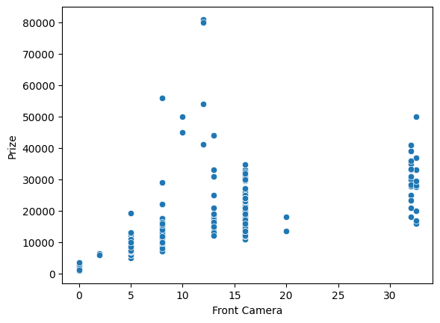
EDA
# Mobile price is slightly affected by front camera

Slide 7
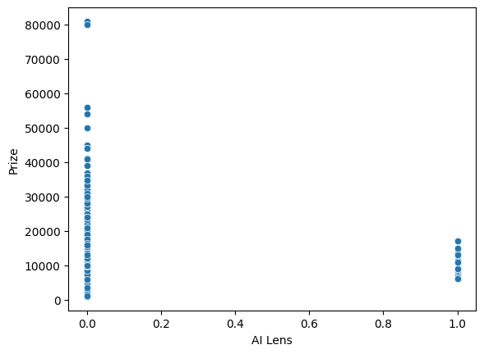
By looking at graph , we are not able to judge the proper relationship between AI Lens and price

Slide 8
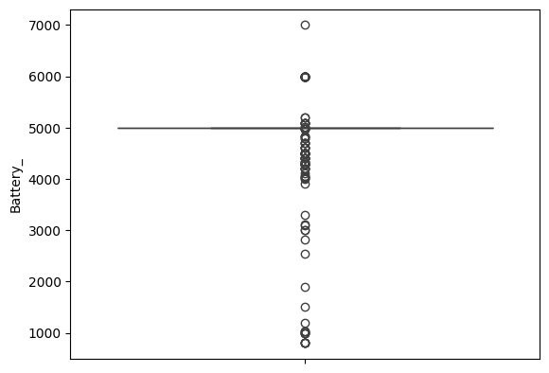
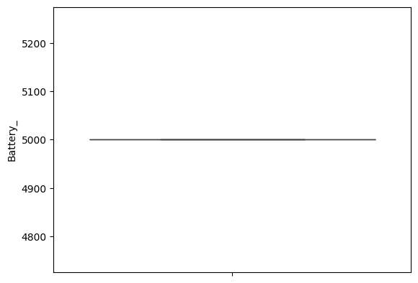
Handling Outliers

Slide 9
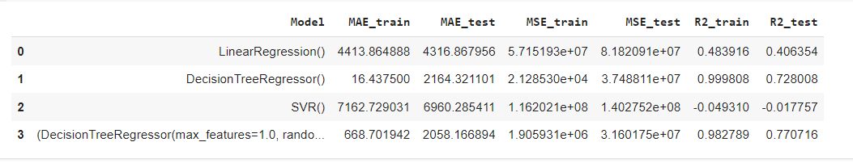
Model Perfomance
g
This is the result when we dont remove any unrelavant column , Random Forest Regressor is performing good among all of them.

Slide 10
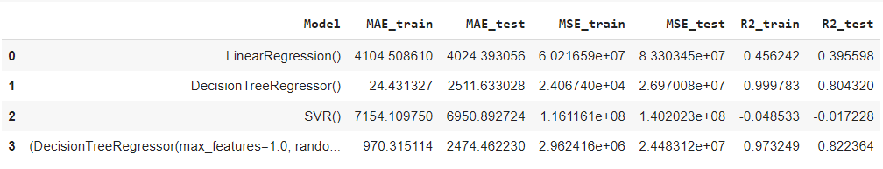
Model Performance
After removing all the unnecessary column and scaling the data . This is our result of
each Model.

Slide 11
Conclusion
Among all of them for data ,SVR performance is worst.
Linear Regression is also not up to the mark.
DT and RF are performing good in training data.
Out of all of them RandomForestRegressor is best model for this dataset . Its R2 score is Performing best in Training as well as testing data .
And its MAE(Mean Absolute Error) is also low as compare to all of them.

Slide 12
Refrences
https://www.kaggle.com/
https://www.youtube.com/
https://www.google.com/

Slide 13
Thanks !!!

